Slide 1


SQL Functions
Transform raw data into meaningful insights with the essential tools of modern database management.

Slide 2


What are SQL Functions?
Mini-Programs
Think of them as tiny programs built into your database that perform specific tasks automatically.
Query Power
Essential for manipulating, calculating, and transforming data directly within your SQL queries.
Input & Output
They accept data as input, process it in some way, and return a transformed result.

Slide 3
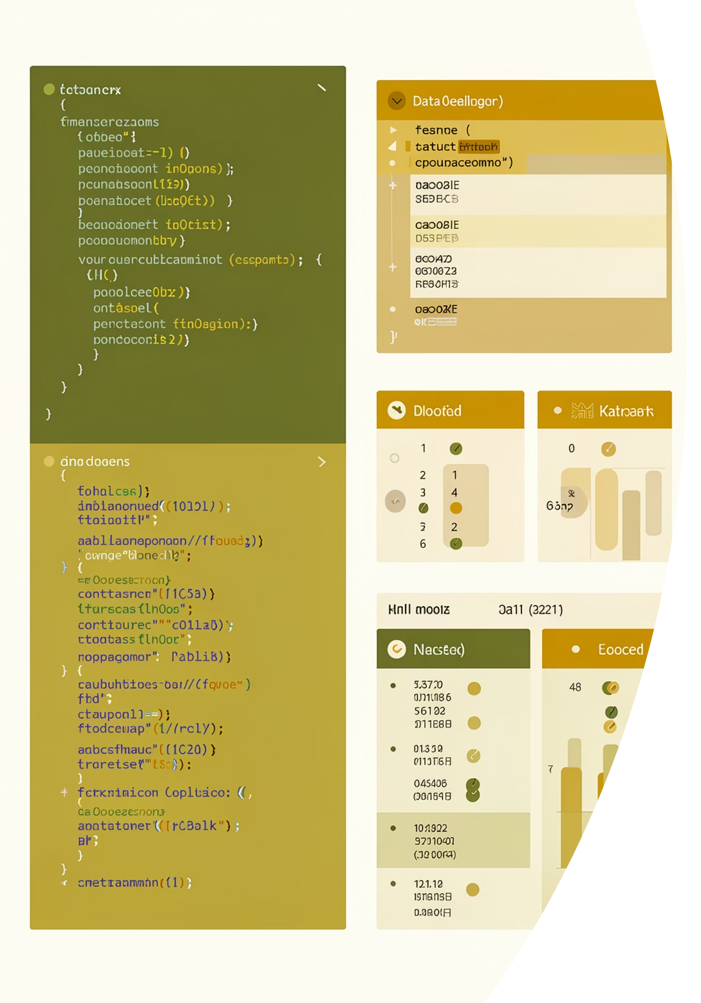
Why Use SQL Functions?
Simplify Complex Tasks
Instead of writing long, complicated code blocks, a single function can accomplish the same task in one line.
Perform Calculations
Easily do mathematical operations like finding averages, sums, or complex statistical calculations on your data.
Manipulate Data
Change text formatting (like making it uppercase), work with dates and times, or transform data types effortlessly.

Slide 4
Common Function Types: Math & Text
Mathematical Functions
ABS() - Get absolute values
ROUND() - Round numbers to specific decimal places
AVG() - Calculate averages across data sets
SQRT() - Find square roots
String Functions
UPPER() - Convert text to uppercase
LOWER() - Convert text to lowercase
LEN() - Get character count
TRIM() - Remove extra spaces

Slide 5
Common Function Types: Dates & Aggregates
Date Functions
GETDATE() - Retrieve current date and time
DATEPART() - Extract specific parts (year, month, day)
DATEDIFF() - Calculate differences between dates
Aggregate Functions
SUM() - Calculate total of values
COUNT() - Count number of items or rows
MAX() and MIN() - Find highest and lowest values

Slide 6
Example: Making Data Shine
The Problem
Customer names stored in inconsistent mixed cases throughout your database.
The Solution
SELECT UPPER(customer_name) FROM customers;
The Result
All names transformed to uppercase instantly, creating consistent, professional data formatting.

Slide 7
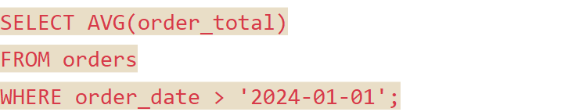
Example: Calculating Averages
Scenario
SQL Code
You need to determine the average order value for your business analysis. Instead of manual calculations, let SQL do the work.
The AVG() function automatically processes all qualifying orders, sums their totals, and divides by the count—delivering the average in seconds.

Slide 8


Beyond the Basics
Built-In Libraries
Custom Functions
Major databases like SQL Server, Oracle, and PostgreSQL offer hundreds of pre-built functions for virtually any data manipulation need.
Create your own specialized functions for unique business requirements, extending SQL's capabilities to match your exact needs.

Slide 9
The Power of Functions
Increased Power
Enhanced Flexibility
Functions make your SQL queries exponentially more powerful by adding advanced processing capabilities.
Combine multiple functions to create sophisticated data transformations that adapt to changing requirements.
Improved Readability
Well-named functions make queries easier to understand, maintain, and share with other team members.
They are fundamental tools that every data professional—from analysts to engineers—relies on daily.

Slide 10
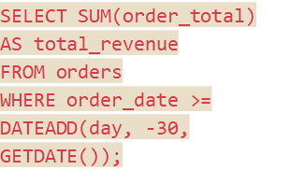
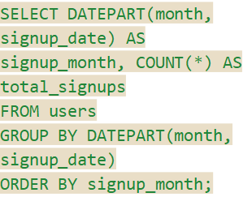
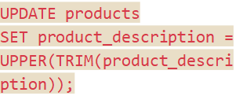
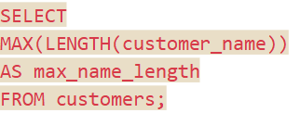
Real-Time SQL Function Examples
Explore practical scenarios where SQL functions bring immediate value to data management and analysis.
E-commerce: Revenue Tracking
Customer Service: Data Optimization
Marketing: Seasonal Trends
Data Cleanup: Product Descriptions
Calculate total revenue from orders in the last 30 days to monitor recent sales performance.
Find the maximum length of customer names to ensure database fields are adequately sized.
Extract the month from user signup dates to analyze and identify seasonal registration patterns.
Remove extra spaces and standardize product descriptions to ensure data consistency and readability.
Clean and consistent product data improves search functionality, reporting accuracy, and overall user experience.
This query quickly aggregates recent sales data, providing a crucial metric for financial reporting and business strategy.
Optimizing field sizes prevents data truncation and improves database performance, crucial for efficient customer record management.
Understanding seasonal trends allows marketing teams to tailor campaigns and resource allocation for maximum impact.

Slide 11
THANK YOU

